Slide 1
Principles of Data Science
Li Niu

Slide 2
Personal information:
(Newly)
Name: 牛力
Research: computer vision/machine learning
Email: ustcnewly@sjtu.edu.cn
Homepage: http://bcmi.sjtu.edu.cn/home/niuli/
Course Material:
ftp://public.sjtu.edu.cn/datasci
username:ustcnewly
password: public

Slide 3
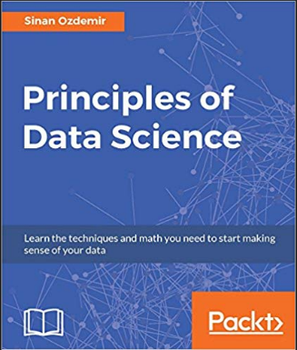
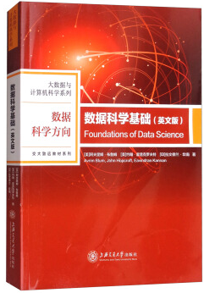
Reference book
Principles of Data Science, Sinan Ozdemir
东南大学出版社, 2017.
Foundation of Data Science, Avrim Blum, John Hopcroft, Eavindran Kannan
上海交通大学出版社, 2017

Slide 4
Preliminary Courses
Linear algebra
Theory of probability
Mathematical logic
Machine learning/Data mining

Slide 5
Course Grading
Attendance/quiz (10%)
Course project (40%)
4 projects, 10% for each
Final exam (50%)

Slide 6

Data is everywhere….

Slide 7
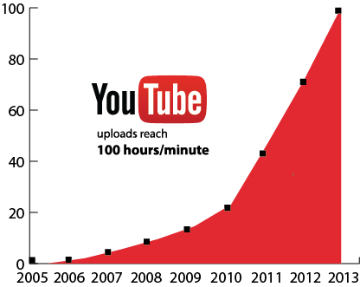
Data is everywhere….

Slide 8
How to categorize data?

Slide 9
Four levels of data
Nominal level: described purely by name (e.g., animal name)
math operation: set
Ordinal level: with ranking order (e.g., grade)
math operation: comparison
Interval level: allows meaningful subtraction (e.g., Celsius temperature)
math operation: subtraction
Ratio level: allows meaningful division (e.g., Kelvin temperature)
math operation: division

Slide 10
Four levels of data
Nominal level
Ordinal level
Interval level
Ratio level
qualitative
quantitative

Slide 11
Quantitative data
no
Describe it using numbers?
qualitative
yes
Does it make sense to
subtract two numbers?
no
qualitative
yes
quantitative

Slide 12
Example
Data: Coffee Shop
• Name of coffee shop (qualitative)
• Revenue (quantitative)
• Zip code (qualitative)
• Average monthly customers (quantitative)
• Country of coffee origin (qualitative)

Slide 13
Now focus on quantitative data….

Slide 14
Discrete or Continuous
Discrete data (e.g., counting)
Continuous data (e.g., weight, height)

Slide 15
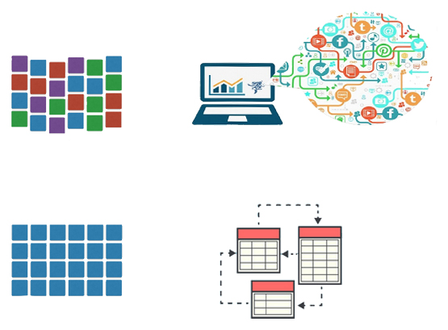
Structure or non-structure
Structured (organized) data: follow certain standard organization hierarchy (e.g., pair, triple, list, tree, graph)
Non-structured (unorganized) data: exists as a free entity and does not follow any standard organization hierarchy
Unstructured data:
free-from online multi-media data (text, image, video)
Structured data:
database

Slide 16
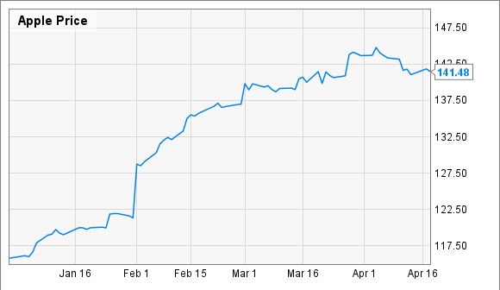
Structured data
Sequence: stock price

Slide 17
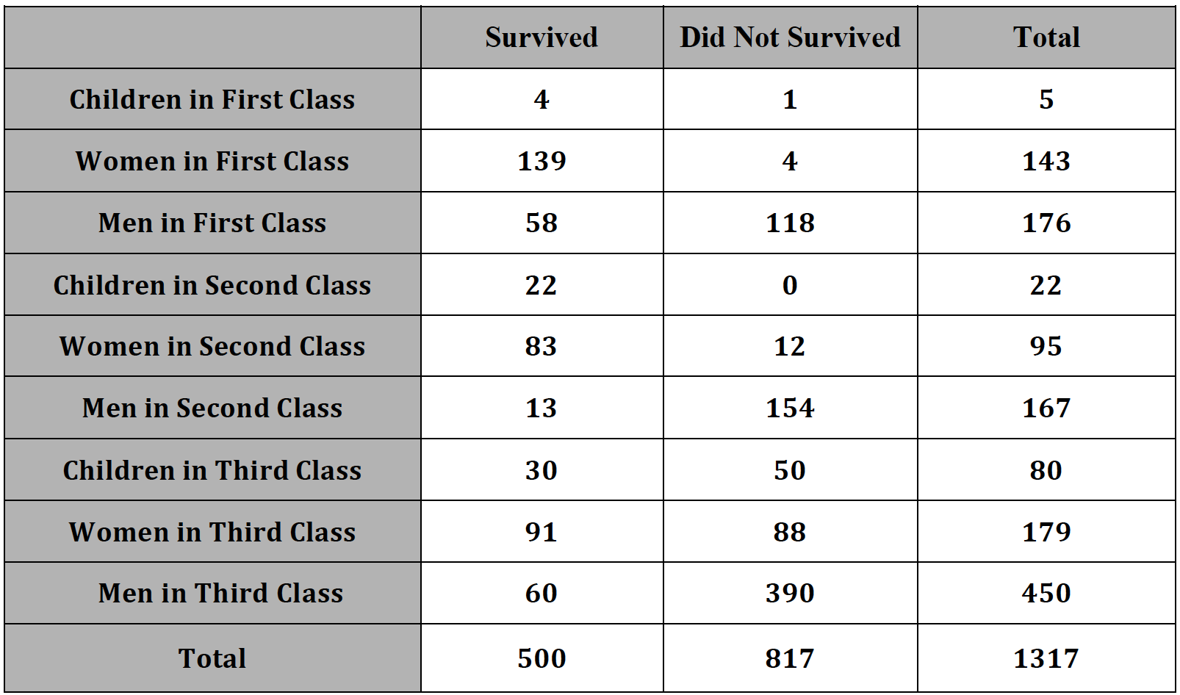
Structured data
Table: survivors on the Titanic

Slide 18
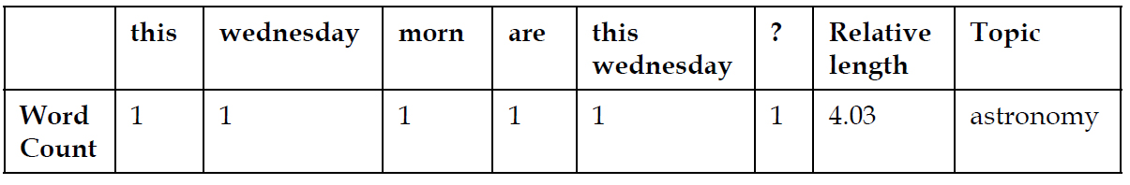
From non-structured data to structured data
Non-structured data:
This Wednesday morn, are you early to rise? Then look East. The Crescent Moon joins Venus & Saturn afloat in the dawn skies.
Structured data:
Word/phrase counts
length
topic

Slide 19
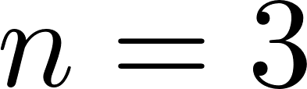
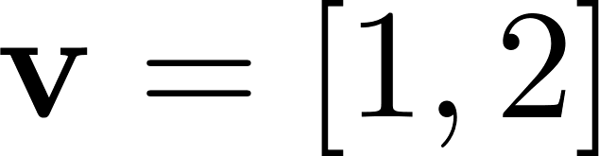
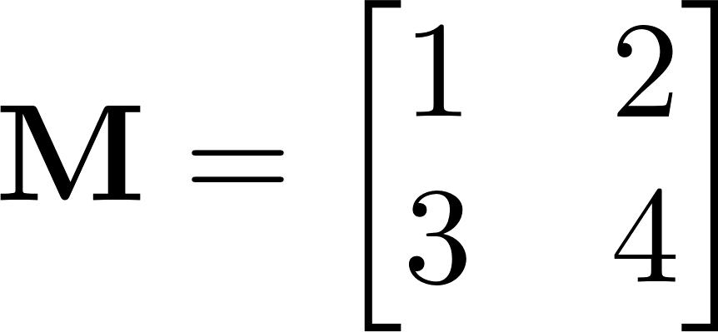
Math annotation
Variable
scalar:
vector:
matrix:

Slide 20
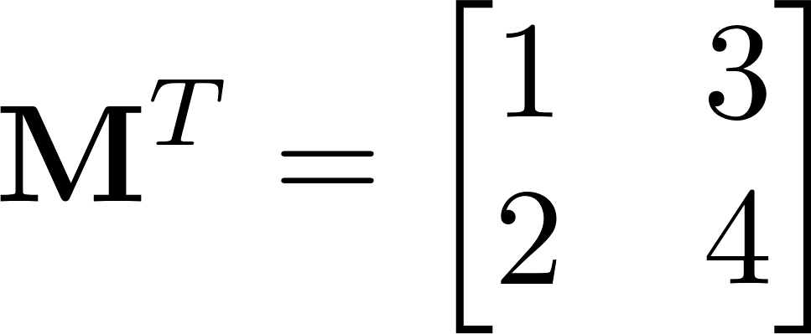
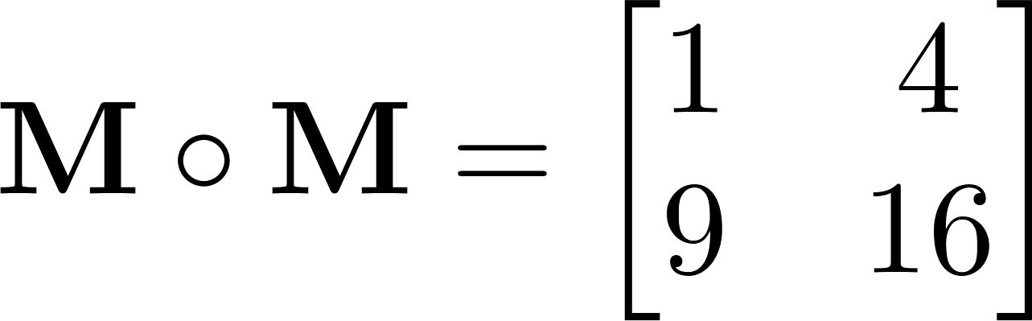
Math annotation
Operation
Transpose:
Element-wise product:

Slide 21


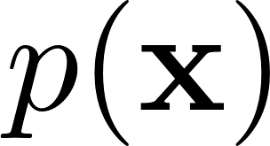

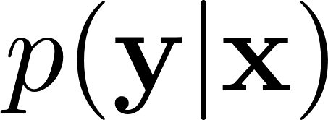
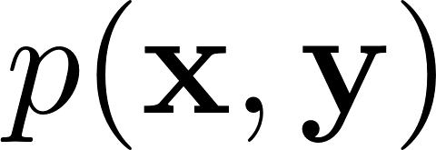

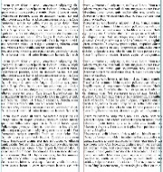
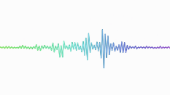
What to learn in this course?
: feature
: target information
Sample 1
image
text
sound
Sample 2
…
Sample n
Data
Feature
Information

Slide 22
Thanks!

